Slide 1






MEASUREMENT
Length

Slide 2
Which one is longer?

Slide 3
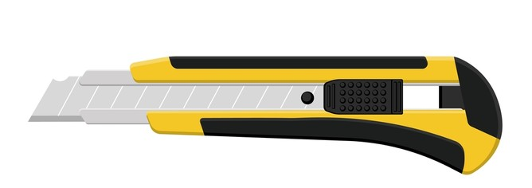
Which one is longer?

Slide 4
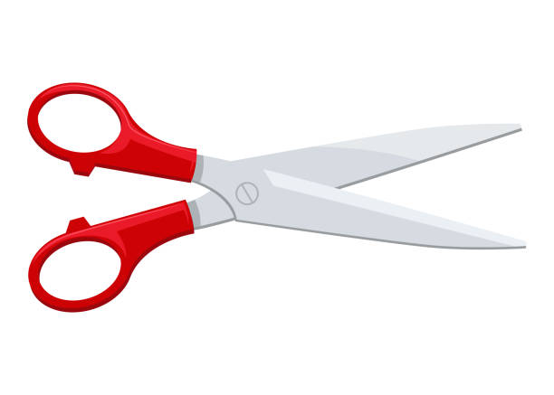
Which one is longer?

Slide 5

How long is this pencil?

Slide 6
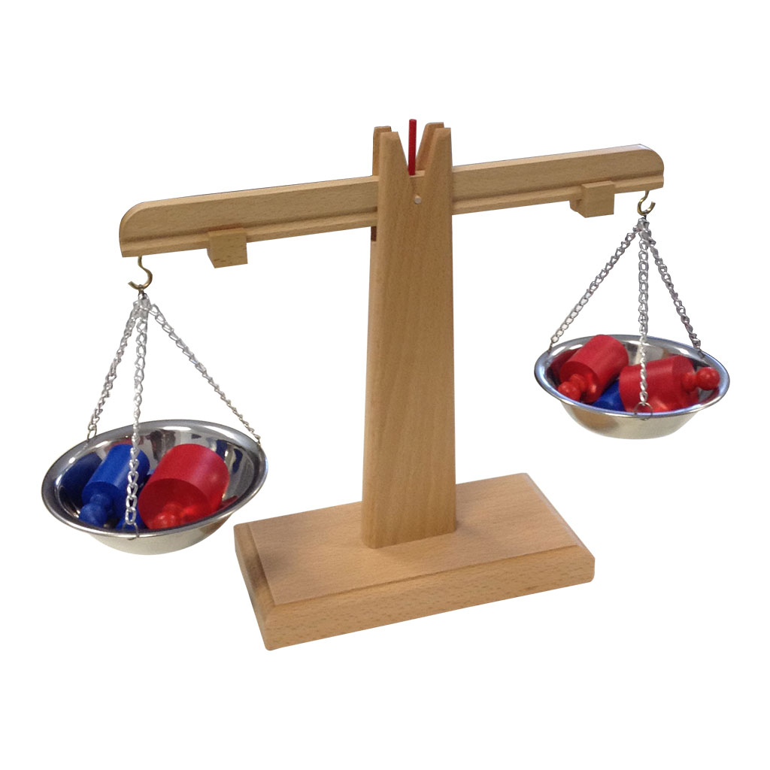
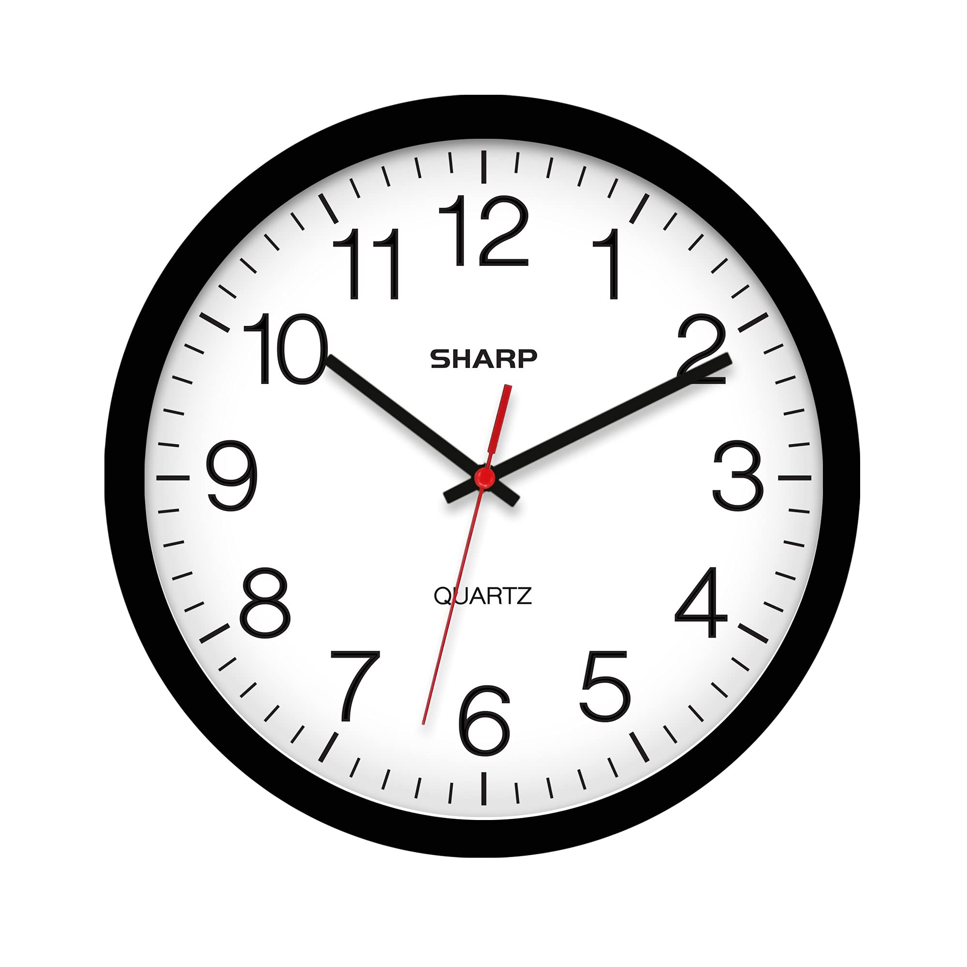
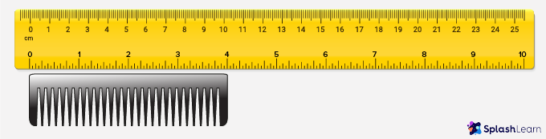
Which one can we use to measure length?

Slide 7
Measuring Tools
ruler

Slide 8
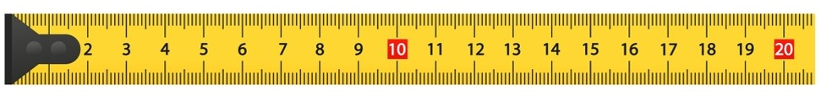
Measuring Tools
meter stick

Slide 9
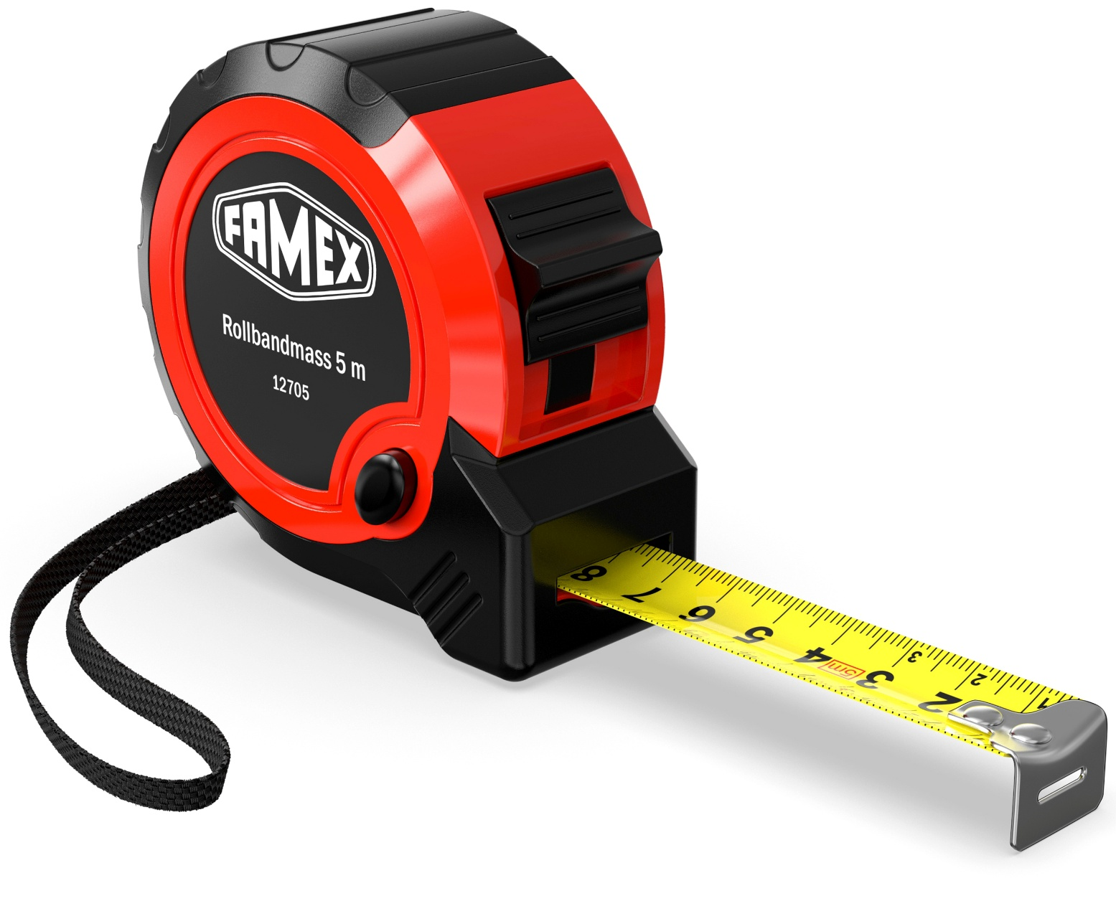
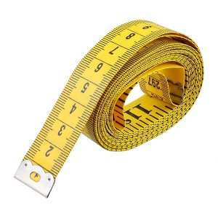
Measuring Tools
measuring tape

Slide 10
What is this measuring tool?
ruler

Slide 11
What is this measuring tool?
a meter stick

Slide 12
What is this measuring tool?
a measuring tape

Slide 13
Which measuring tool is best to measure this pencil?

Slide 14
Let’s measure this pencil together!!!

Slide 15

How long is the pencil?
14 cm
0
1
2
3
4
5
6
7
8
9
10
11
12
13
14
15
16
17
18

Slide 16

How long is the pencil?
11 cm
0
1
2
3
4
5
6
7
8
9
10
11
12
13
14
15
16
17
18

Slide 17
How long is the cutter?
8 cm
0
1
2
3
4
5
6
7
8
9
10
11
12
13
14
15
16
17
18

Slide 18
How long are the scissors?
8 cm
0
1
2
3
4
5
6
7
8
9
10
11
12
13
14
15
16
17
18

Slide 19
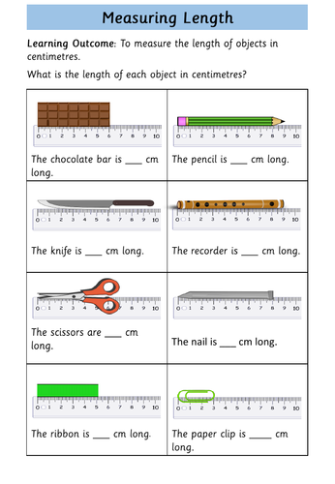
Let’s practice measuring.

Slide 20
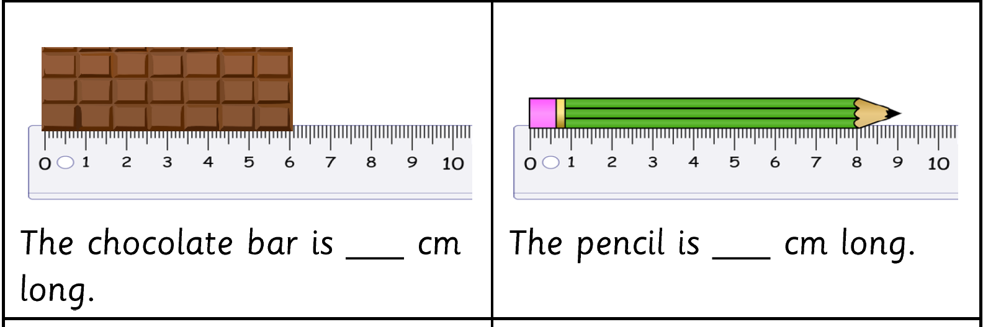
6

Slide 21
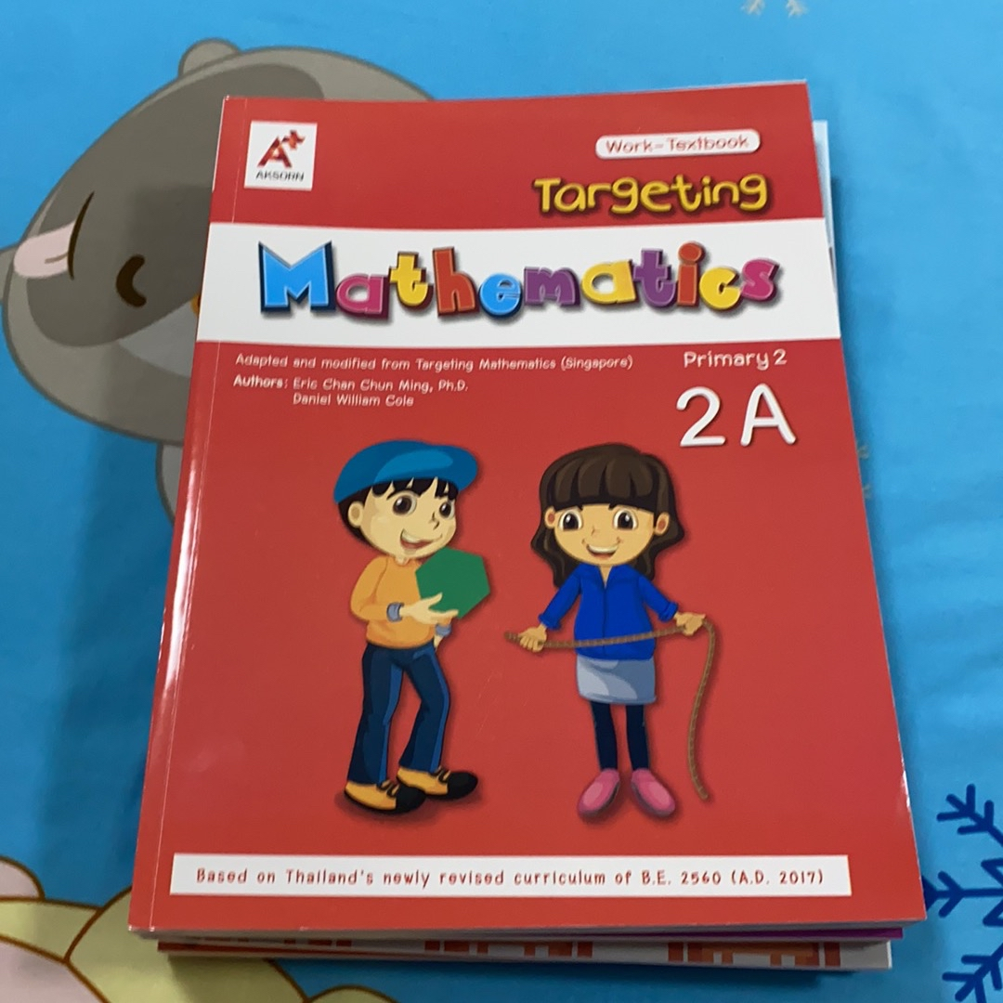
Let’s measure your book!
How long is your book?

Slide 22
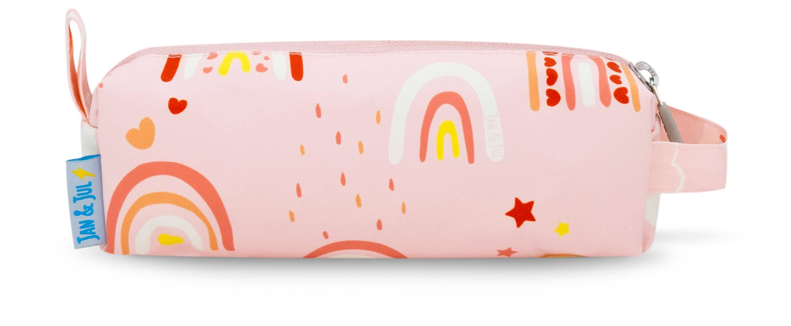
Let’s measure your pencil case!
How long is your pencil case?

Slide 23
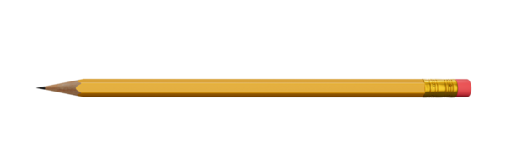
Let’s measure your pencil!
How long is your pencil?

Slide 24
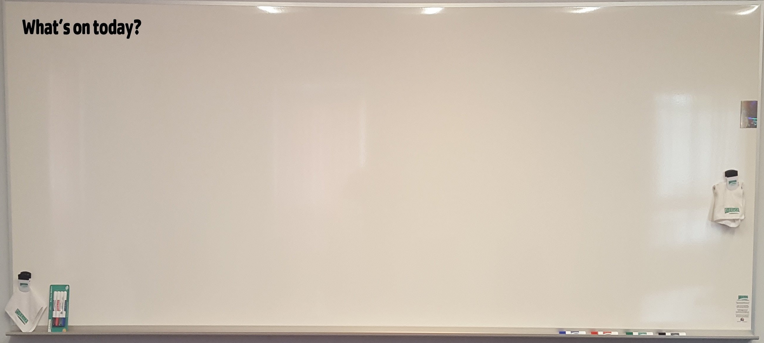
How long is our whiteboard?

Slide 25

Which measuring tools can we use to measure the whiteboard?

Slide 26
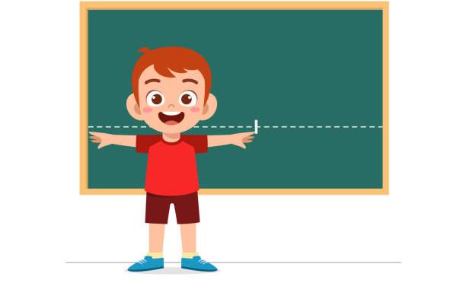
Next class, let’s measure our whiteboard together!!!

